Slide 1
Web Assignment2
Group 31: TV Shop
Ke Yan
Jiongbin Li
Juncheng Piao

Slide 2
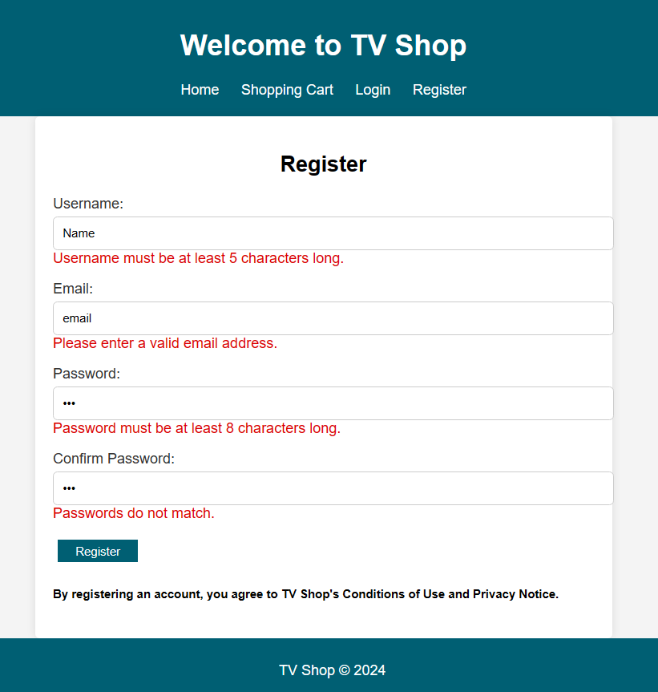

Register

Slide 3
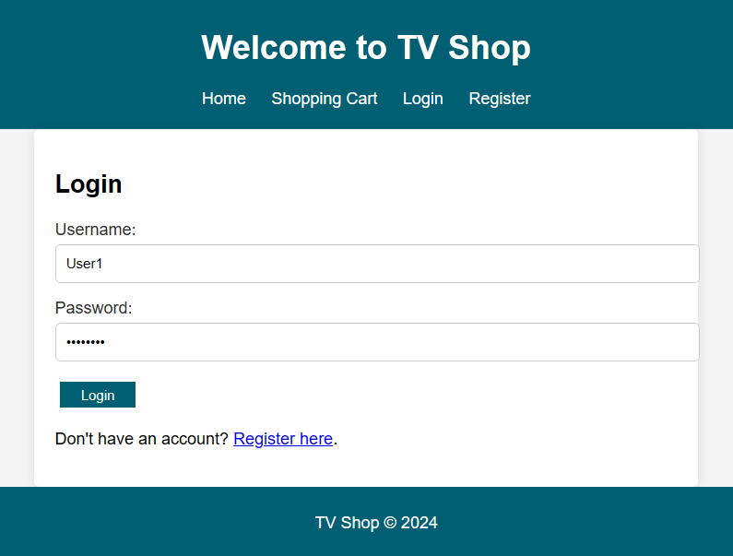

Login

Slide 4
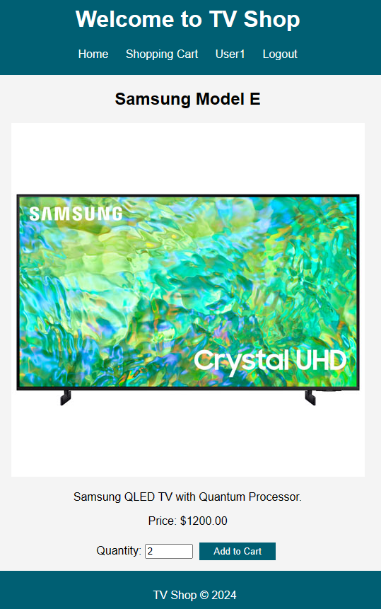



Shopping Cart

Slide 5
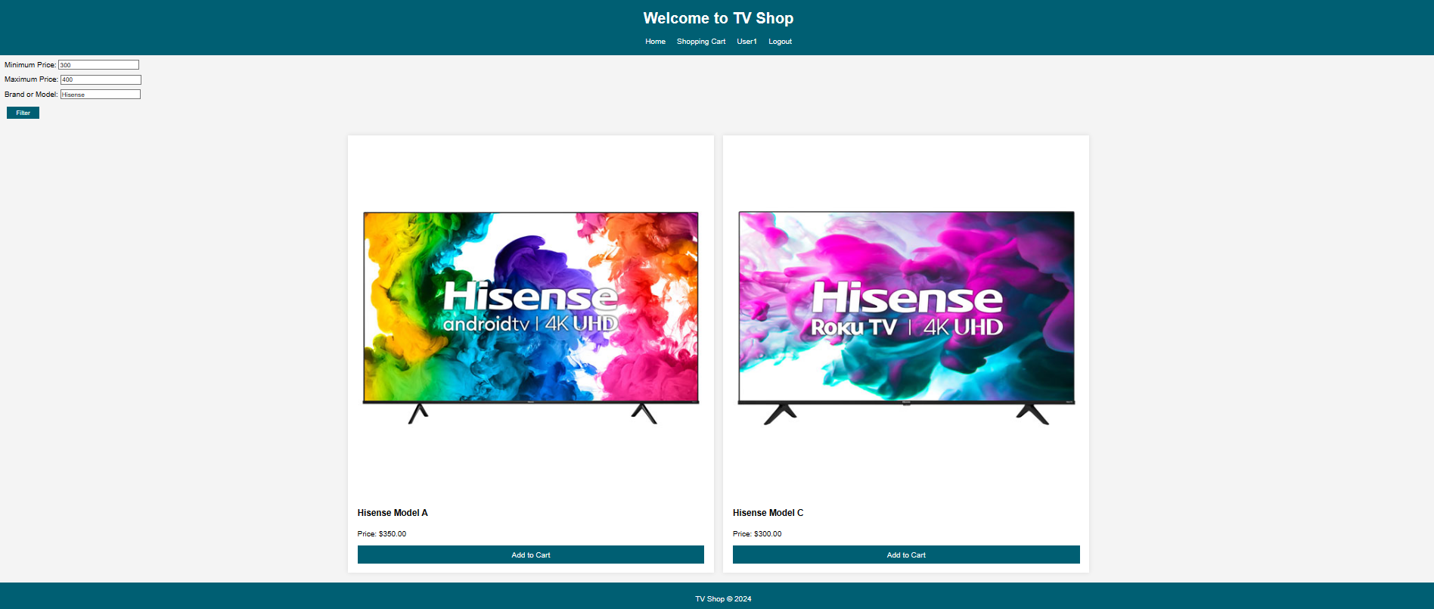
Filter

Slide 6
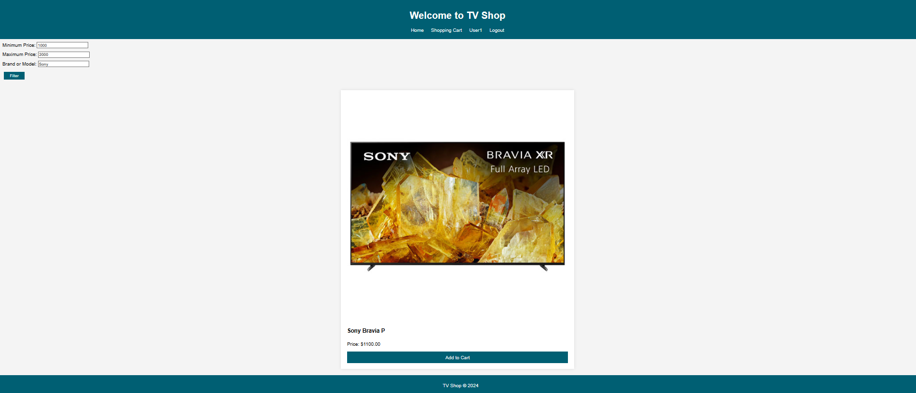
Filter

